Slide 1
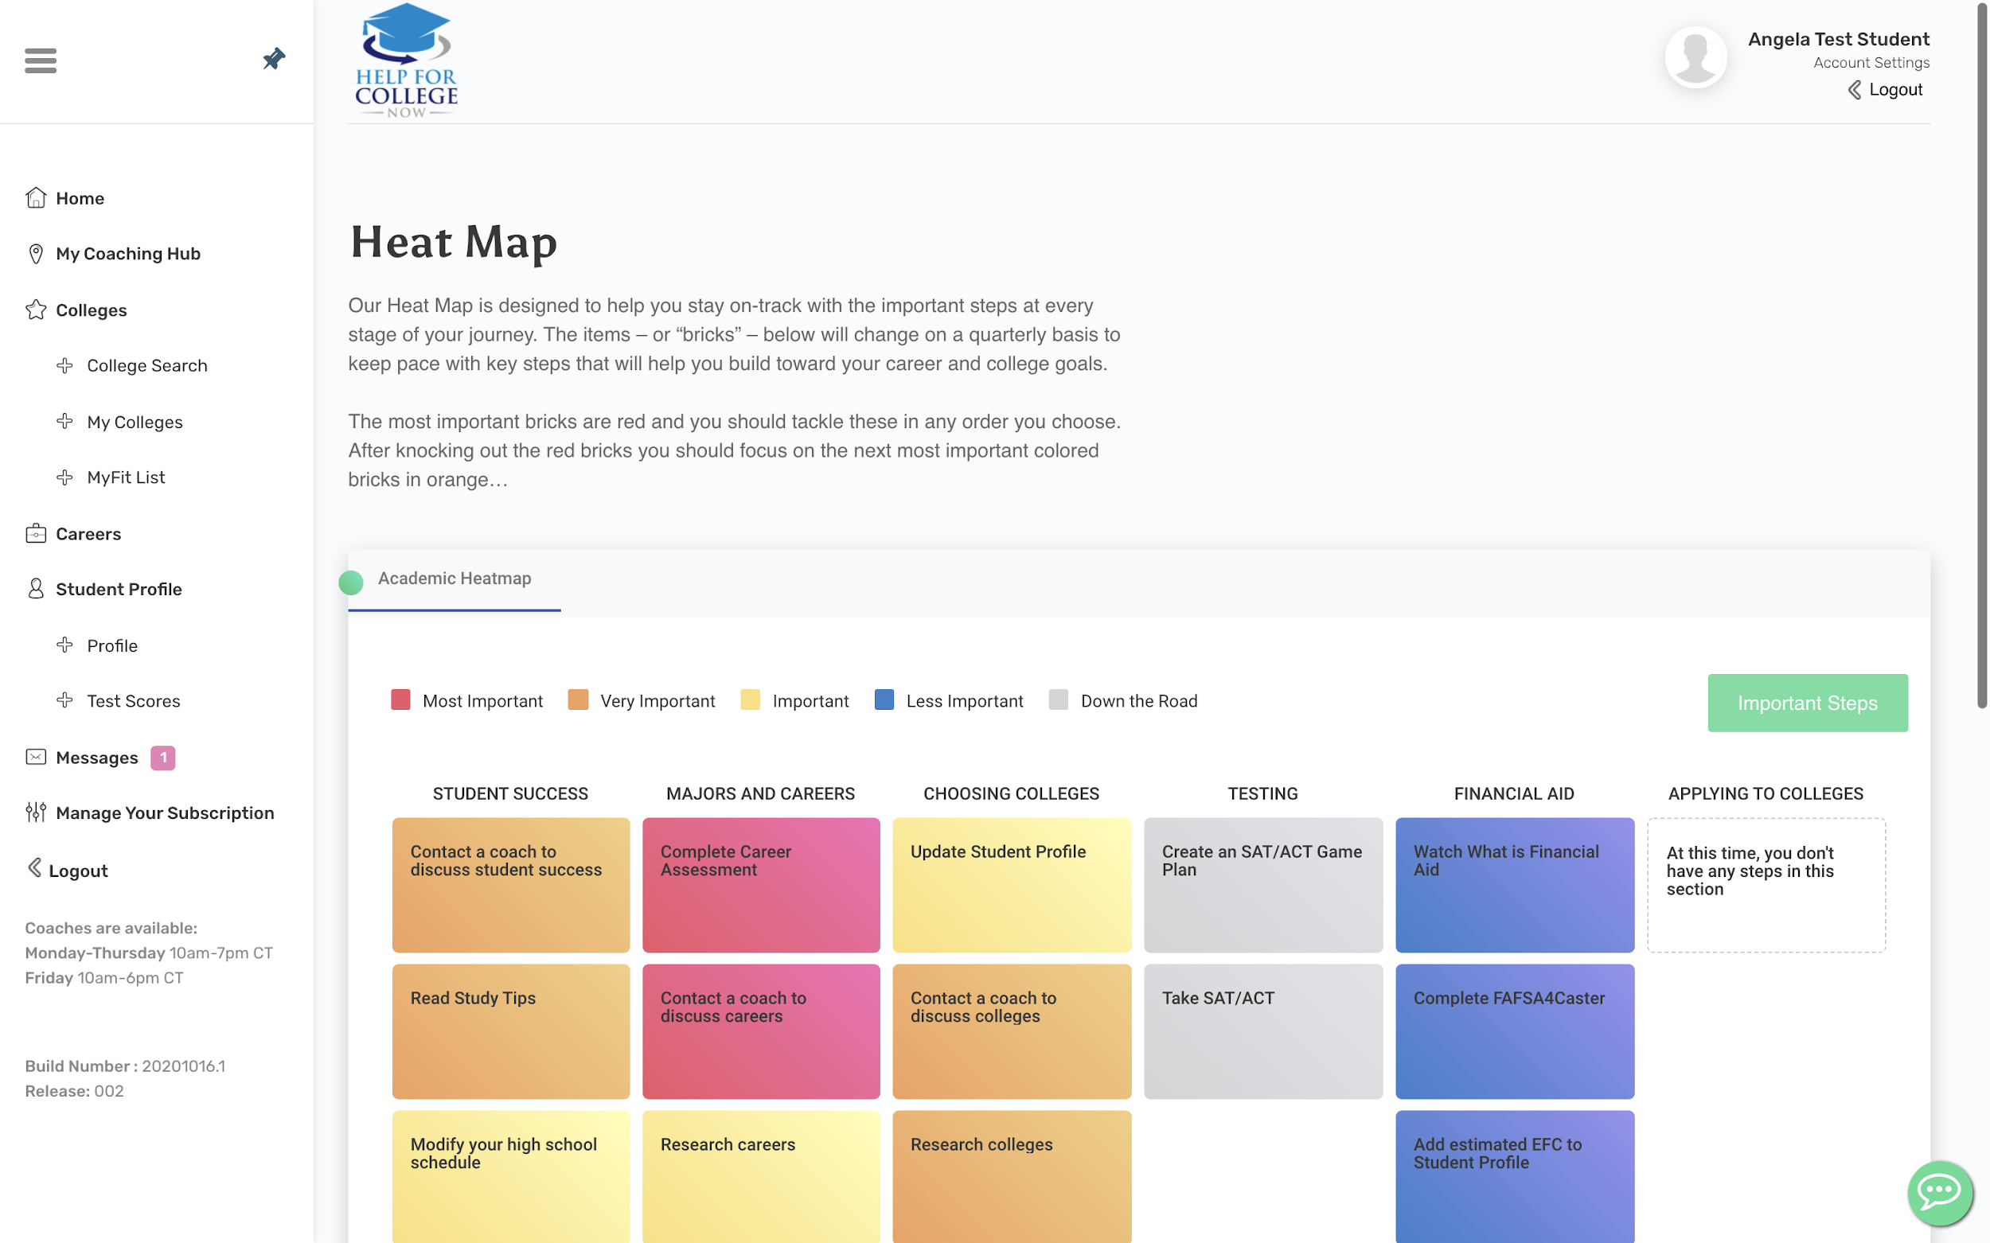
Your Envision platform will help you stay on-track throughout your college admissions and career journey!
Easily connect with your coaches online!

Slide 2
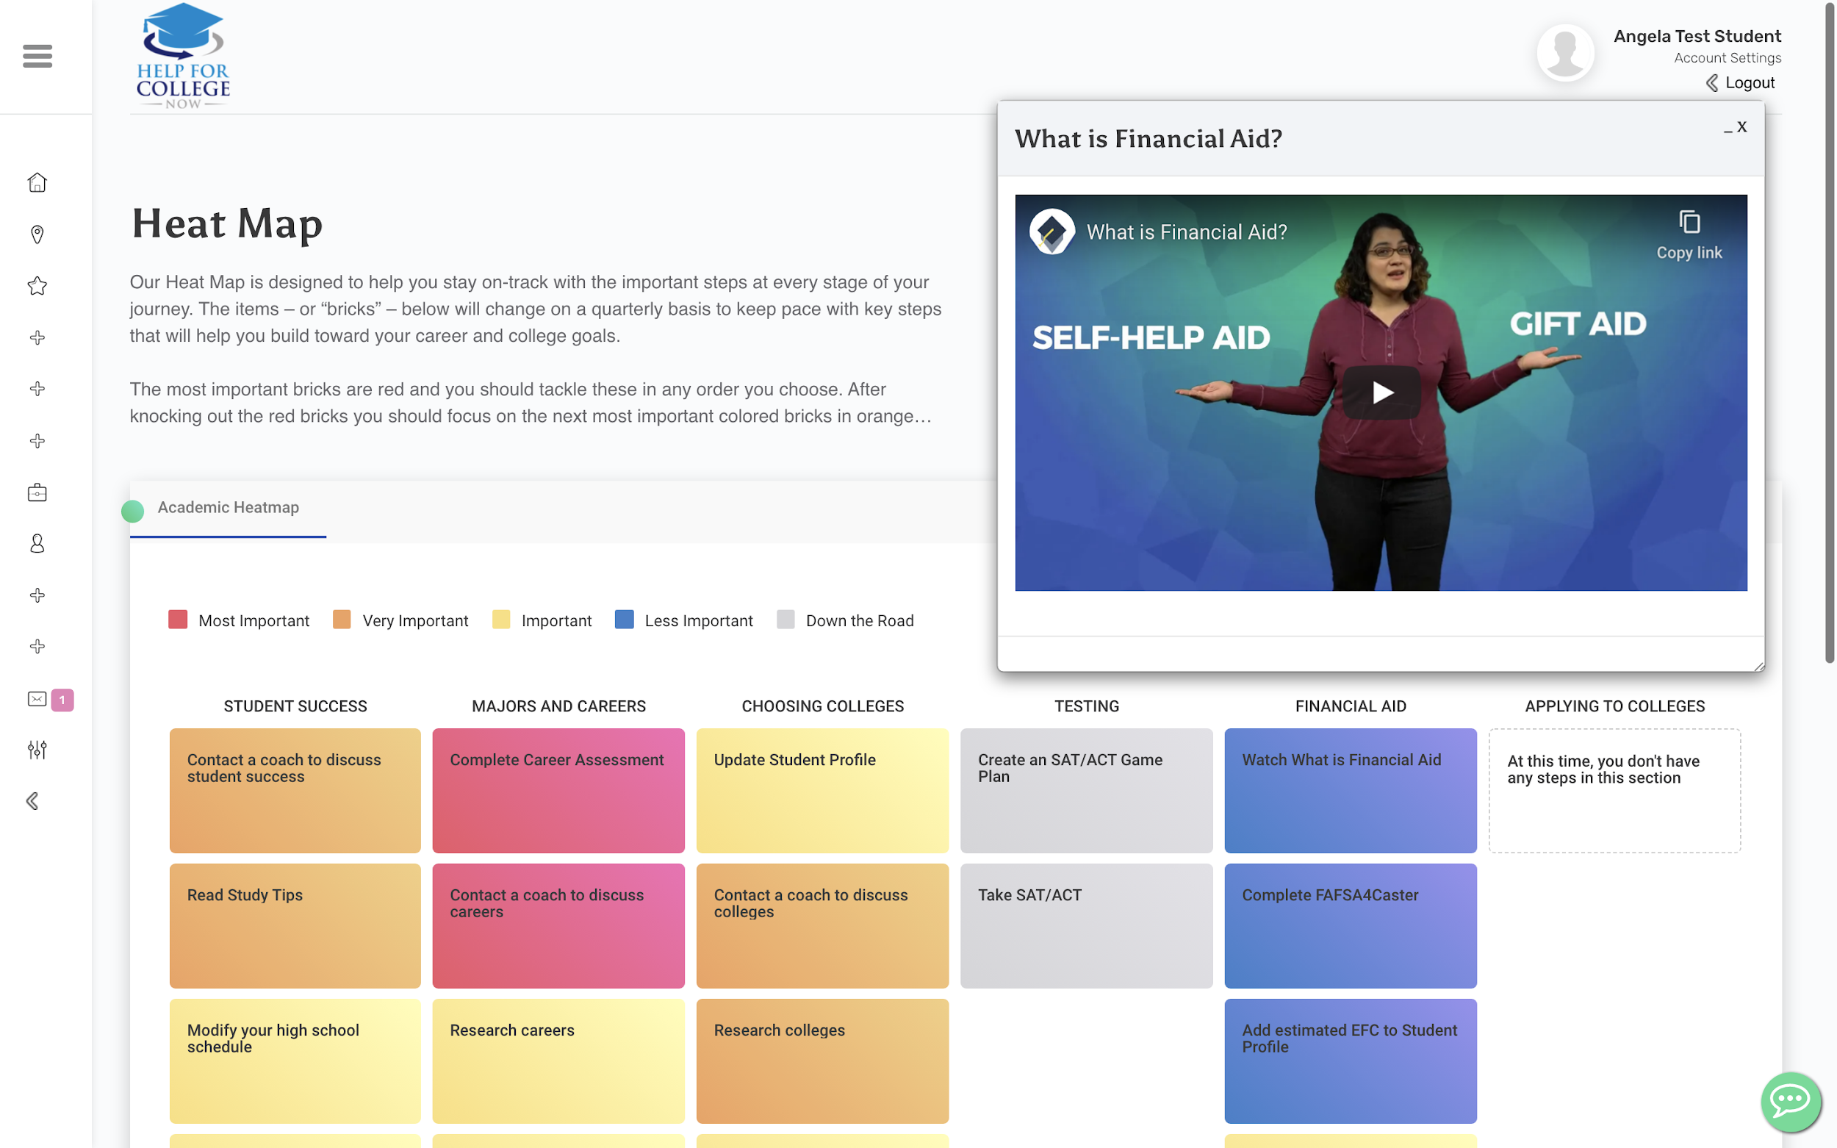
Our videos will help breakdown larger concepts and help you make wise choices about your future.
Your Heat Map will adapt to where you are in the process and change over time ensuring that the most relevant steps are a click away.

Slide 3
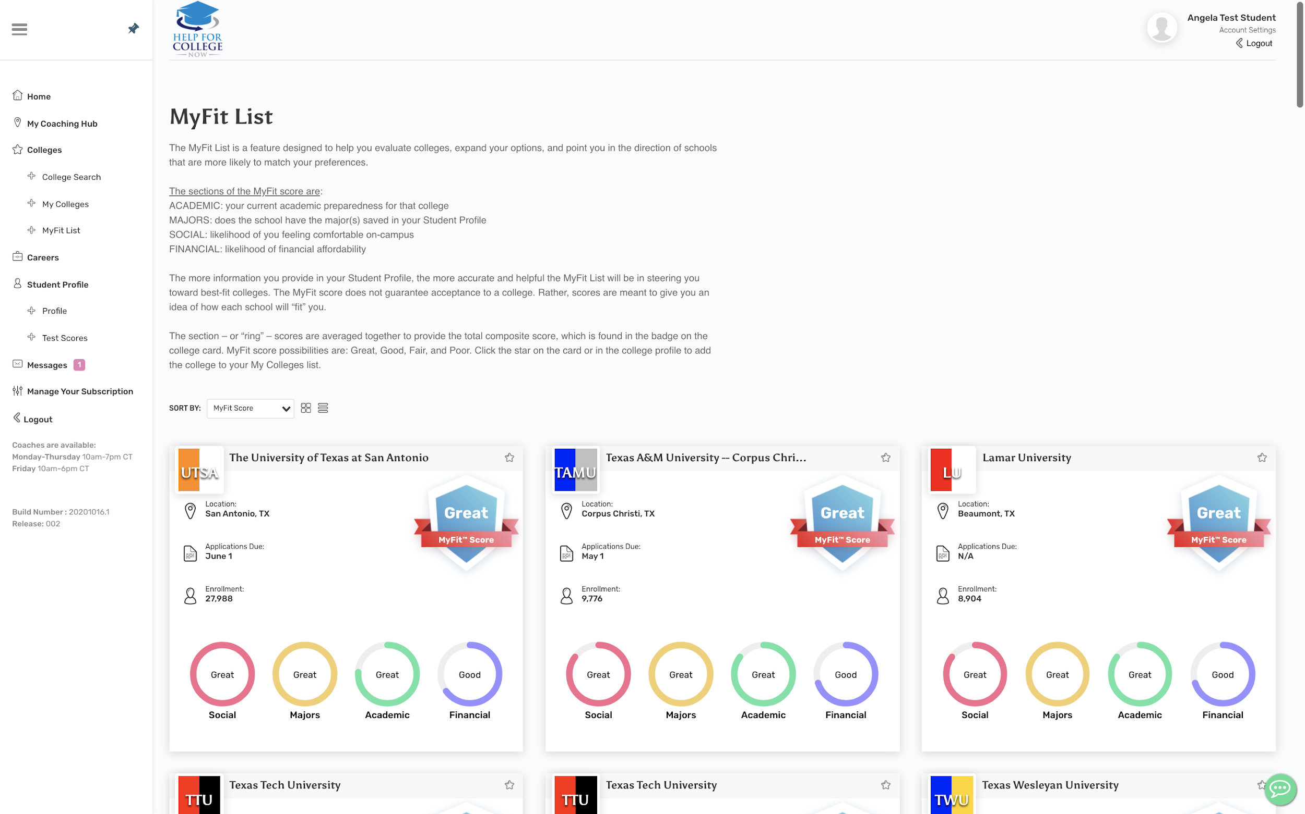
Our proprietary MyFit is like a dating app for colleges. Using our industry knowledge and your Student Profile information, we will set a MyFit score for every college in our database to help you with your college search!

Slide 4
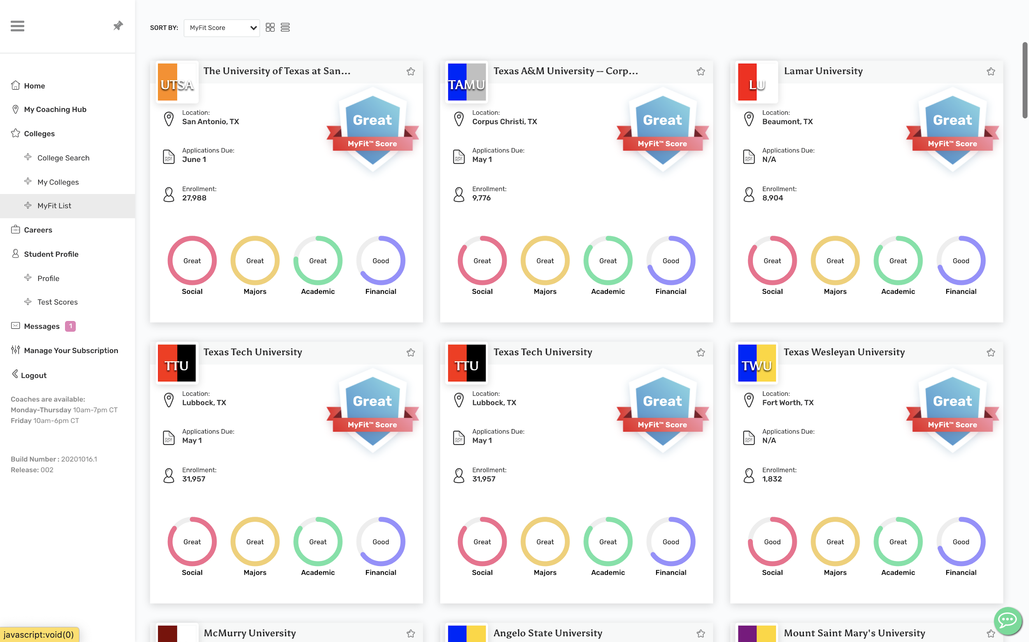
The overall MyFit score for each school will help you quickly analyze your college options.
The MyFit score is broken into four sections and is updated when you modify your Student Profile:
Social
Majors
Academic
Financial

Slide 5
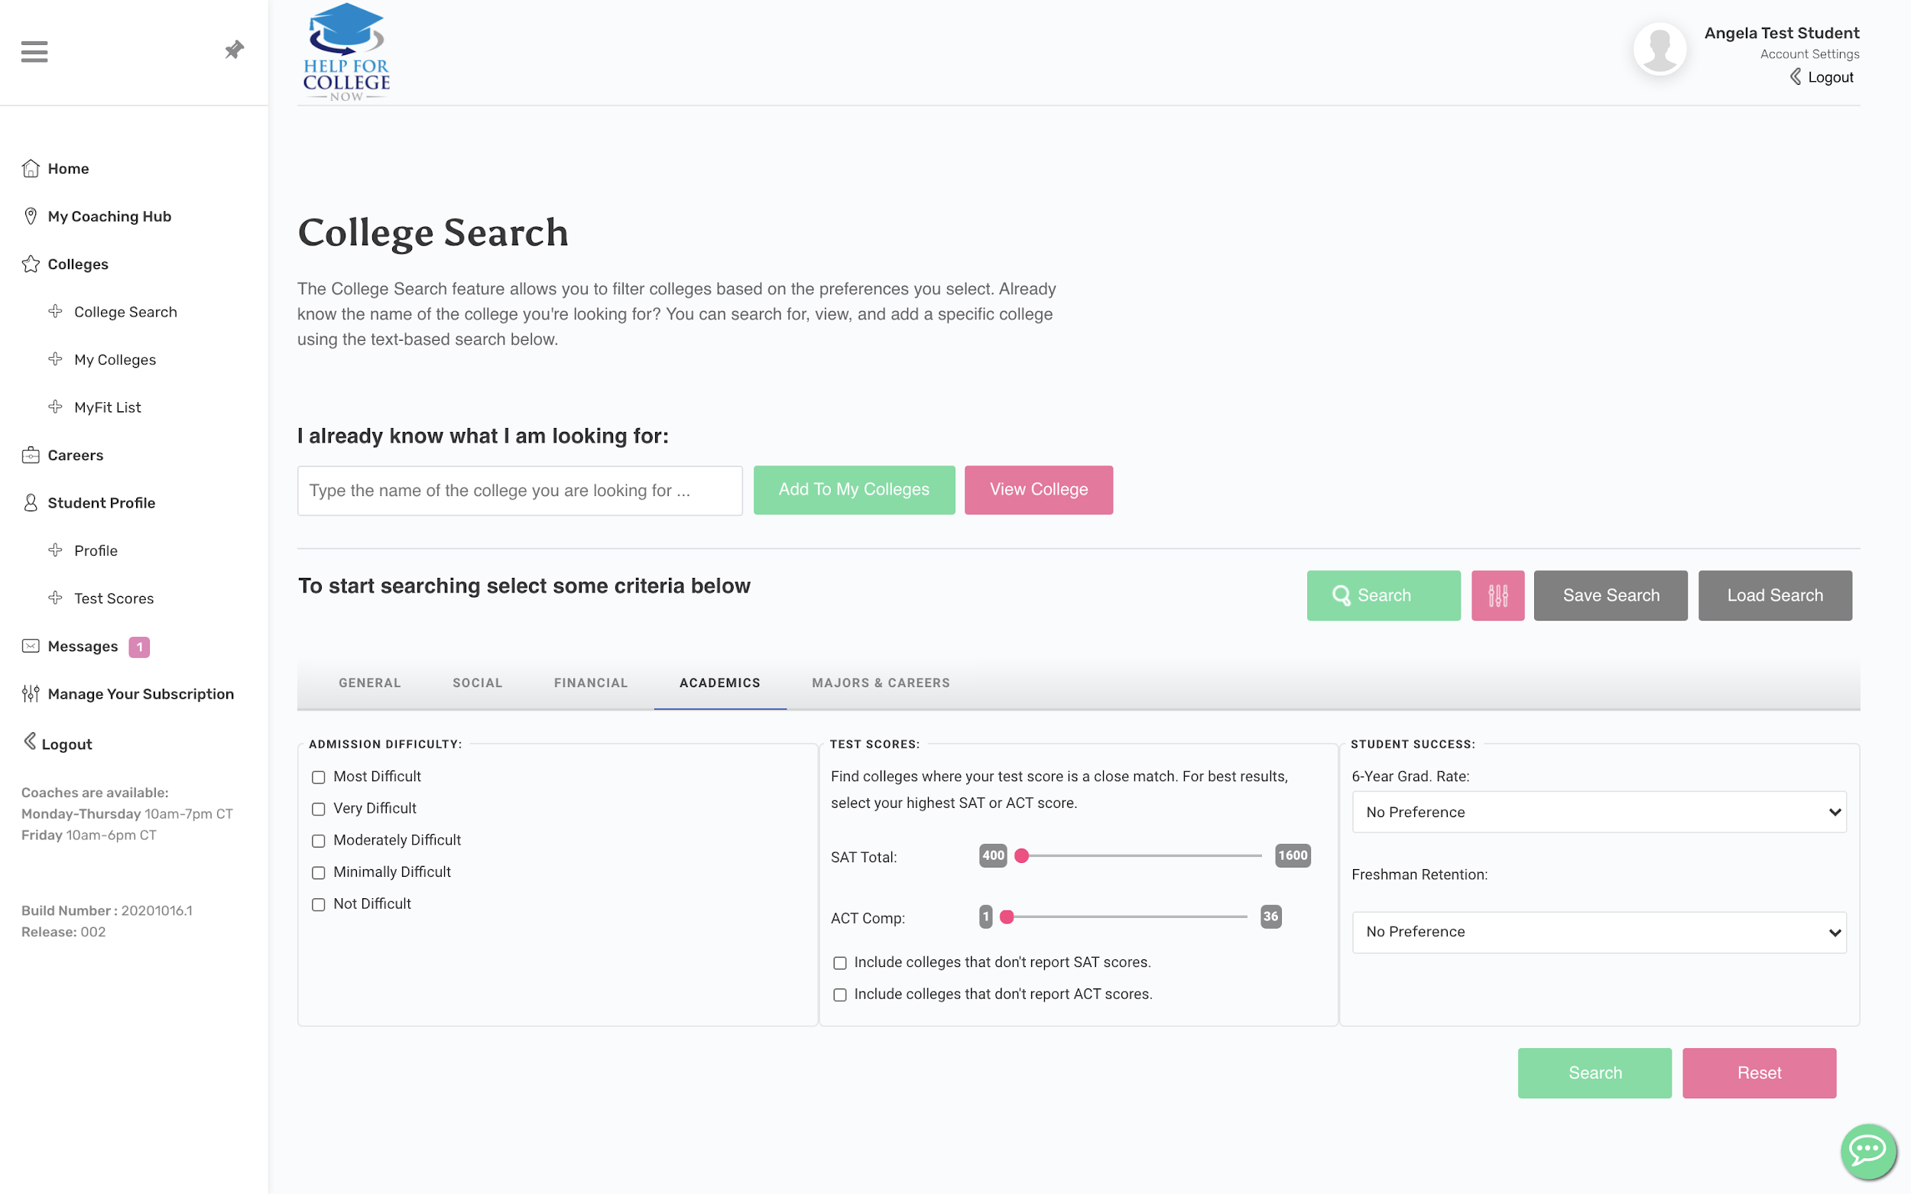
As you develop your college preferences, our College Search tool will help you continue to discover colleges and help you hone in on right-fit colleges.

Slide 6
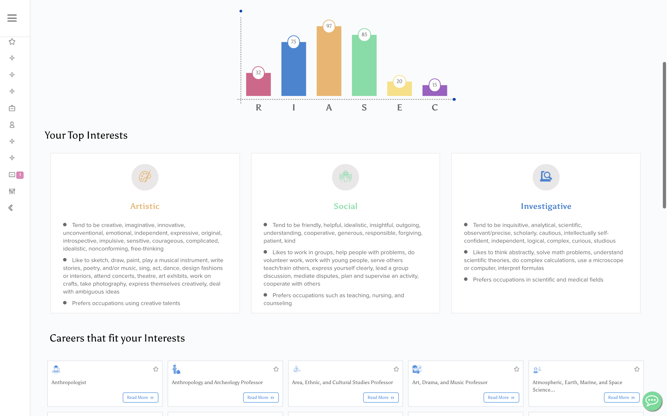
Learn more about yourself and gain confidence in your career by taking our Career Assessment.
You will receive career suggestions based off your top interests. Coaches can help you on your career journey.

Slide 7
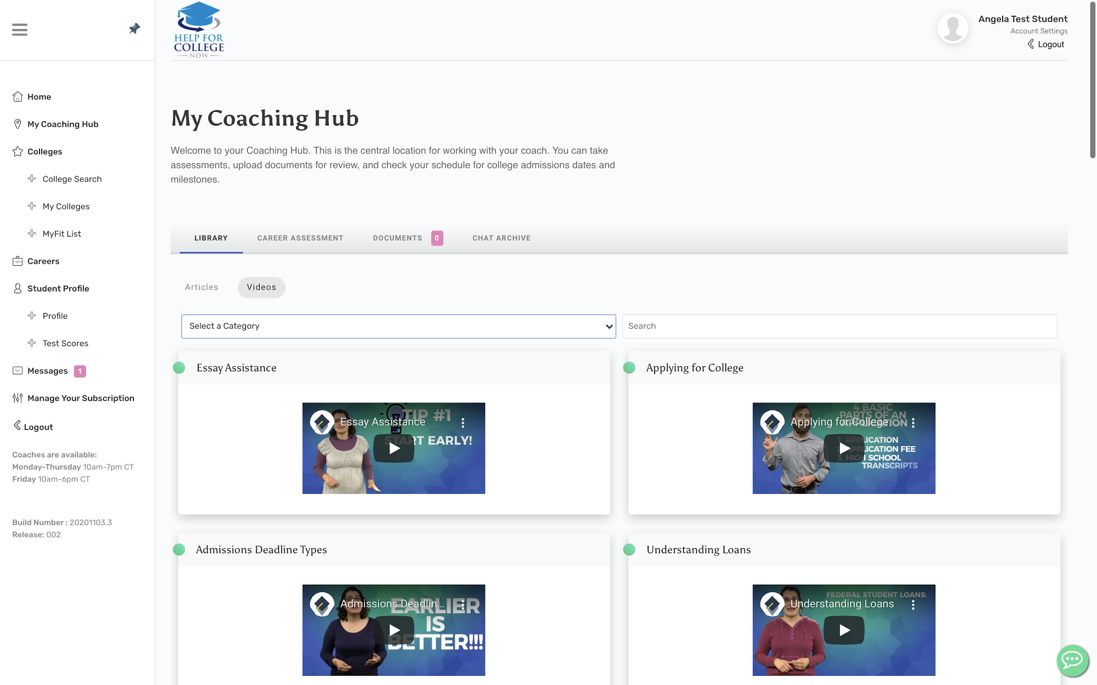
Through Envision you gain access to our library of articles and videos to help educate you on important career and college planning topics.

Slide 8
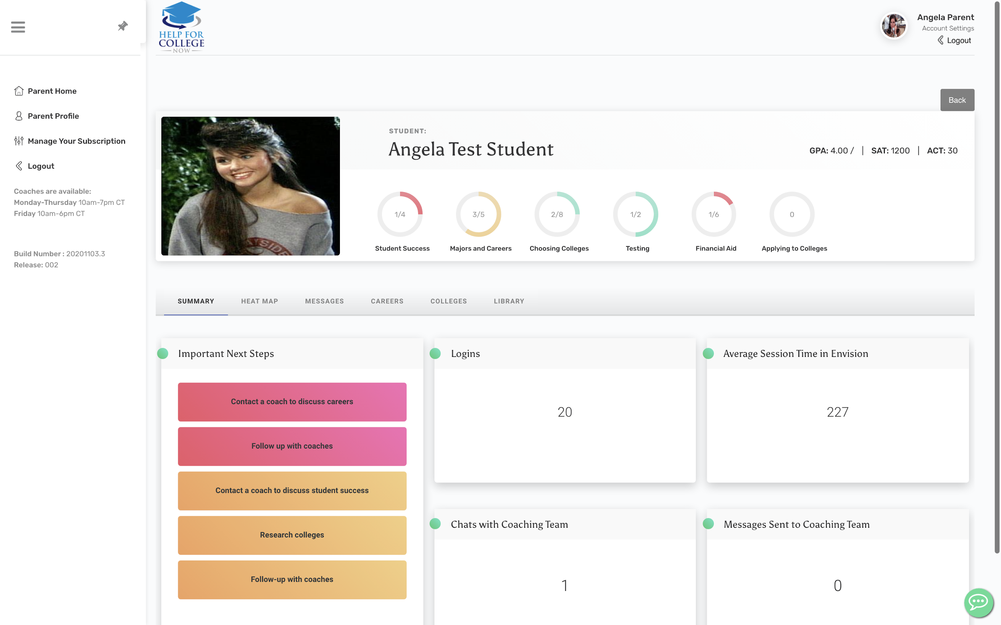
Parents have access to their own Envision portal to track their student’s progress in the program.
Track how many steps your student has completed in each section of their Heat Map or view their next steps.

